Slide 1
Deep Learning
with Viktor Reichert
viktor.reichert@conteco.gmbh

Slide 2
Introduction
Name:
Job role:
Experience with Python:
Experience with Deep Learning:
Do you have Kaggle Account?

Slide 3
Kaggle notebooks
https://www.kaggle.com/code/viktorreichert/mnist-basics
https://www.kaggle.com/code/viktorreichert/sign-language-with-mobilenet
https://www.kaggle.com/code/viktorreichert/rnn-steam-rating
https://www.kaggle.com/code/bulentsiyah/deep-learning-based-semantic-segmentation-keras

Slide 4
What is AI?
AI is intelligence that emanates from a machine and not from a living being.
A machine is said to be "intelligent" when it can perceive its environment and make decisions based on a goal.
(Or you can define it a little differently to better fit your current field.)
Examples:
YouTube recommendations
Facebook auto tagging
Self-Driving Cars
Social media face filters
Artificial Intelligence (AI)

Slide 5
Specialized or Generalized?
Narrow AI specializes in a specific task.
Arificial general intelligence (AGI) is capable of performing any human intellectual task.
AGI is not yet fully resolved.
AI
General AI
Narrow AI

Slide 6
What is Machine Learining?
Machine learning describes the use of algorithms
to analyze data
to learn from data
to self-improve
make a prediction or decision about new data.
We don't give any human-made rules for the decision, but only develop a model that compiles the rules itself.
Example: Fraud detection when using credit cards
Some models:
Linear regression
Decision Trees
Support Vector Machines (SVM)
Naive Bayes Classifiers
K-Nearest Neighbor
Artificial Neural Networks (Deep Learning)
Artificial Intelligence (AI)
Machine Learning

Slide 7
What is Deep Learning?
Deep learning is a special machine learning algorithm based on artificial neural networks (ANNs).
ANNs are inspired by how biological neural networks (“brains”) work.
Artificial Intelligence (AI)
Machine Learning
Deep Learning

Slide 8

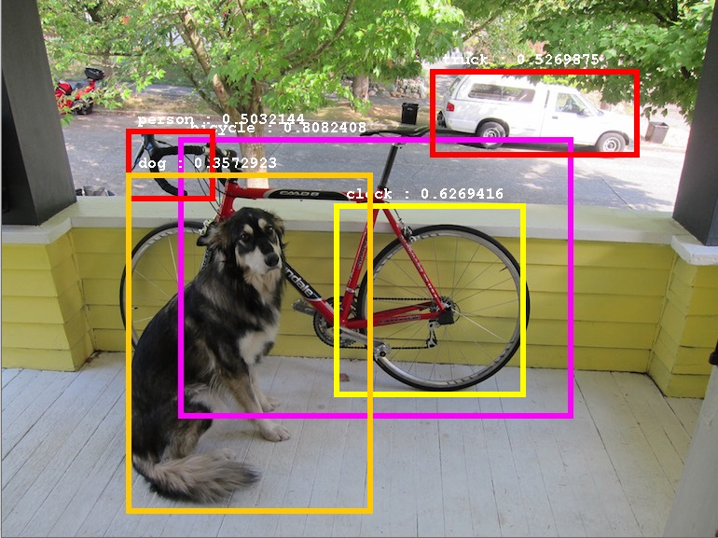
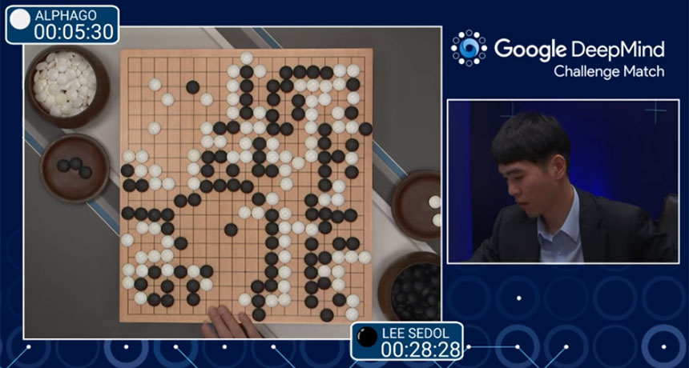

Applications of Deep Learning
Image Classification
Object Detection
Recommendation Systems
Gameplay (AlphaGo)
Image Generation (NightCafe)
…
Notes:
https://blog.jetbrains.com/kotlin/2022/01/object-detection-with-kotlindl-and-ktor/

Slide 9
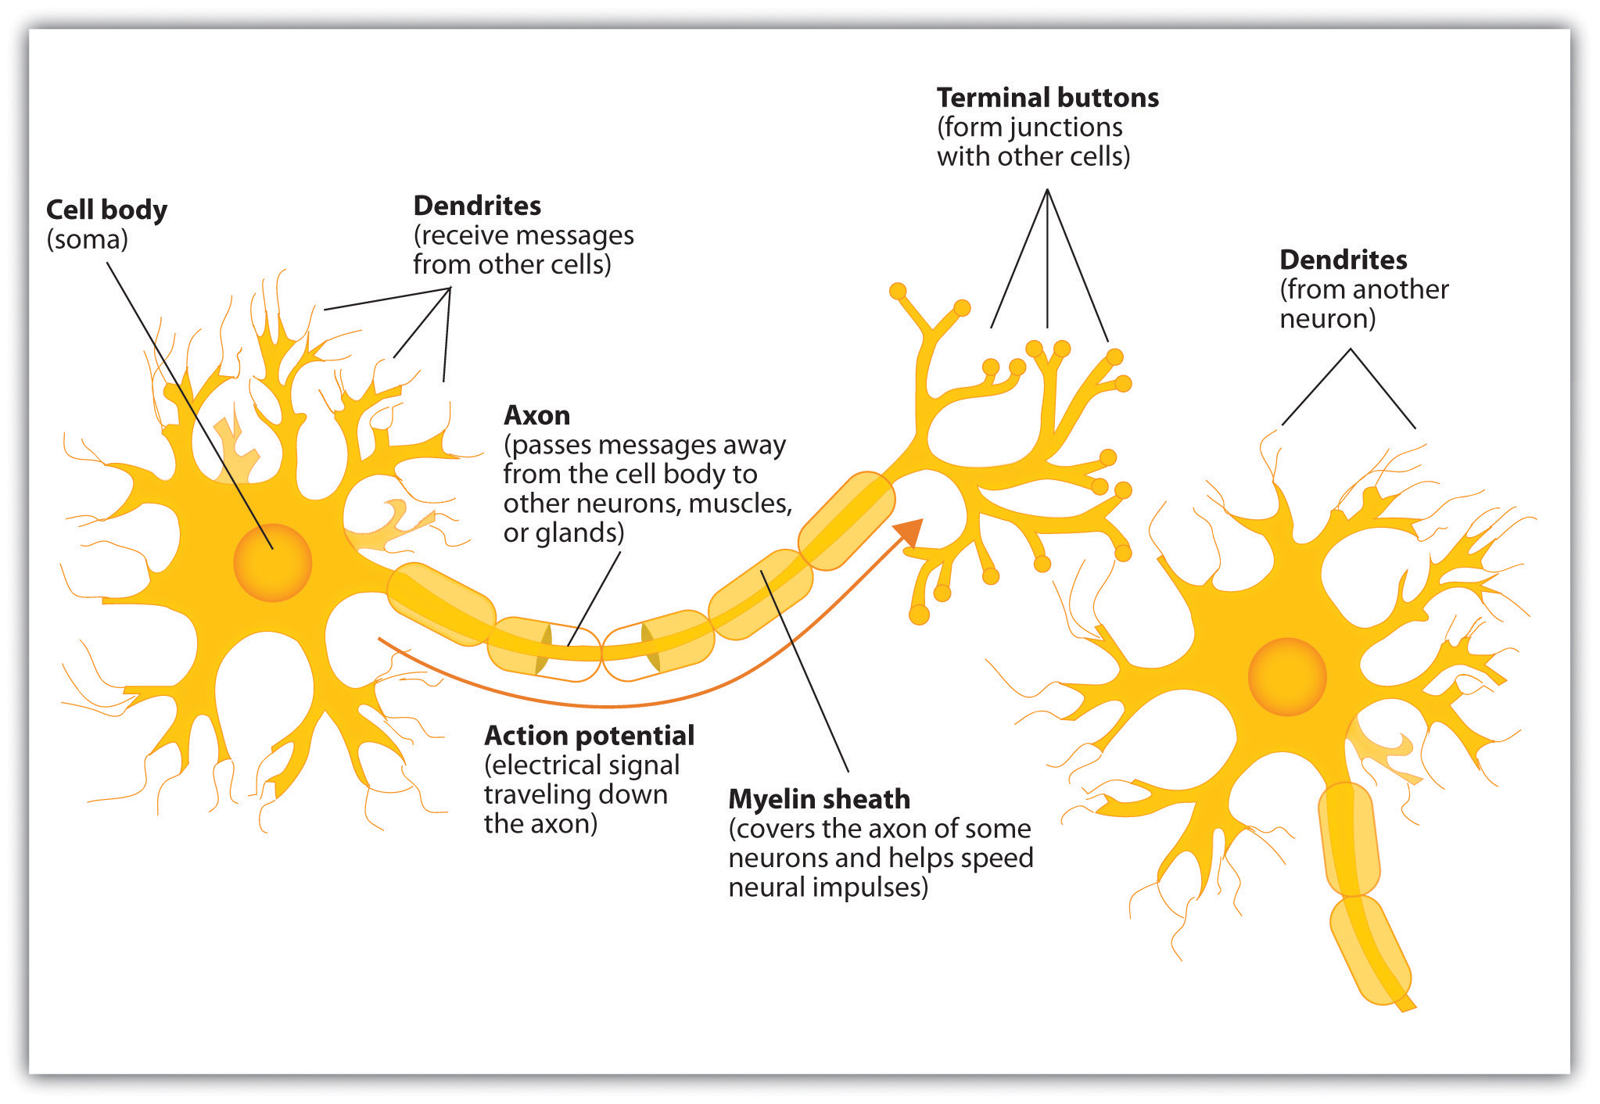
Biological neural networks
Transportation and evaluation of information within an animals body is done via neurons.
Neurons send electrical impulses via chemical processes.

Slide 10
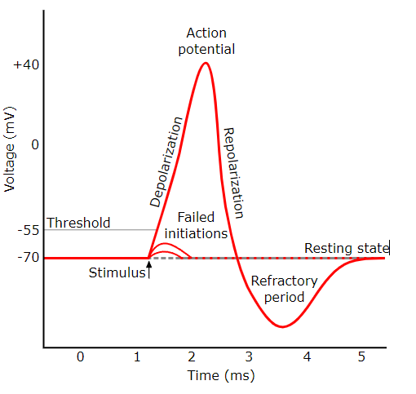
Biological neural networks
Via dendrites a neuron is charged by other connected neurons.
When the charge is high enough, the neuron itself is „firing“ a signal to the neurons connected to his terminal buttons.
This signal mey either increase or decrease the electrical potential of the connected neurons.
If the Potential is high enough the neurons might fire themself. Otherwise the potential decreases over time.

Slide 11
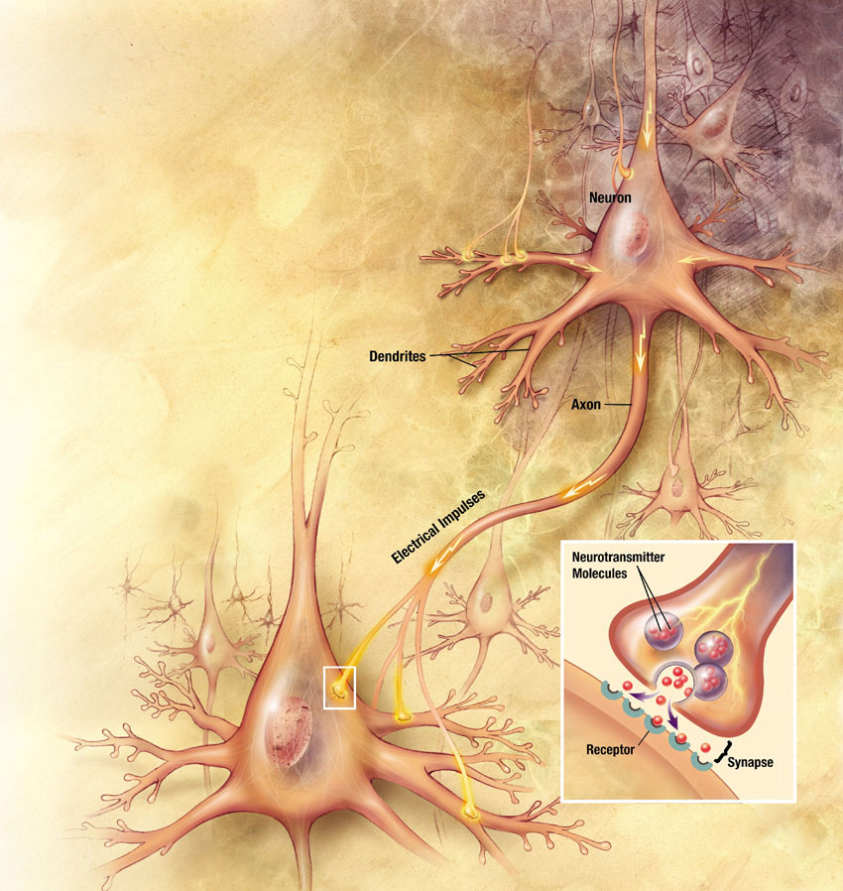
Biological neural networks
Von Action_potential.svg: Original by en:User:Chris 73, updated by en:User:Diberri,
converted to SVG by tiZomderivative work: de:Benutzer:Jnns - Action_potential.svg,
CC BY-SA 3.0, https://commons.wikimedia.org/w/index.php?curid=10316004

Slide 12
Biological neural networks
Biologial neuron are highly complex structures.
We can discribe the inner workings of biological neurons quite well, but they are very hard to calculate.
It‘s still unclear how biological neural networks „think“ or really „decide“. A brain is more then the sum of it‘s parts.
This is (mainly) also true for artificial neural networks (ANN)!
We define and connect the building blocks in our ANNs, but we only have a vague understanding of the internal importance of them.
Nethertheless the perform great in many different tasks (like our brains ;)

Slide 13
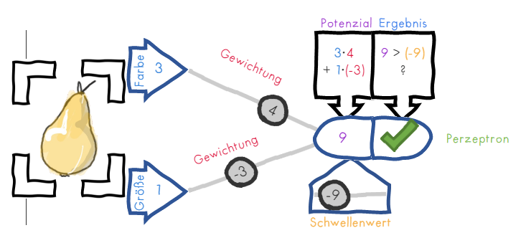
Perceptron
The simplest type of neural networks are perceptrons.
Introduction to the topic: https://tiluha.github.io/perceptron/
At the same time, these form the building block from which more complex neural networks are assembled.

Slide 14
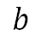
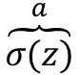
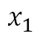
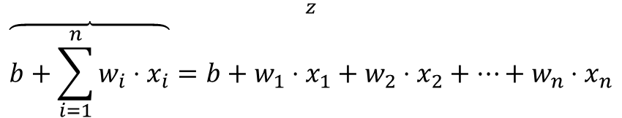
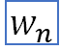
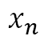
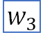
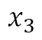
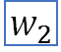
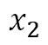
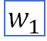
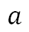
Translate biologie to model
There are different levels of abstraction for biological neurons.
In Deep Learning we are using Perceptrons:
Input
$$\overset{z}{\overbrace{b+\sum_{i=1}^{n}{w_{i}⋅x_{i}}}=b+w_{1}⋅x_{1}+w_{2}⋅x_{2}+…+w_{n}⋅x_{n}}$$
$$x_{1}$$
weights
$$x_{2}$$
$$w_{1}$$
$$w_{2}$$
output
$$x_{3}$$
$$w_{3}$$
$$\overset{a}{\overbrace{σ(z)}}$$
$$a$$
$$w_{n}$$
$$x_{n}$$
activation function σ
$$b$$
Bias/Threshold

Slide 15
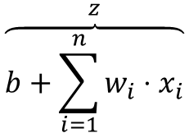
Calculation of the output
The inputs are first multiplied by weights and then added.
The result is then passed to an activation function.
The training process consists of adjusting the weights and thresholds.
Input
$$x_{1}$$
weights
$$w_{1}$$
$$x_{2}$$
$$w_{2}$$
$$\overset{z}{\overbrace{b+\sum_{i=1}^{n}{w_{i}⋅x_{i}}}}$$
output
$$x_{3}$$
$$w_{3}$$
$$\overset{a}{\overbrace{σ(z)}}$$
$$a$$
$$w_{n}$$
$$x_{n}$$
activation function σ
$$b$$
Bias/Threshold

Slide 16

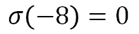
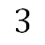
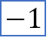
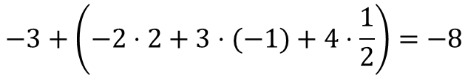
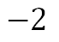

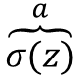
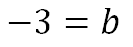
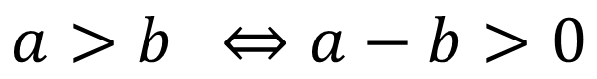
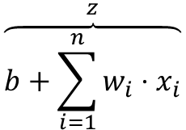
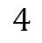
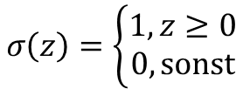
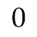
Example Calculation
Input
$$\overset{z}{\overbrace{b+\sum_{i=1}^{n}{w_{i}⋅x_{i}}}}$$
weights
$$\overset{a}{\overbrace{σ(z)}}$$
$$−2$$
$$2$$
$$3$$
$$−1$$
output
$$4$$
$$−3+\left(−2⋅2+3⋅(−1)+4⋅\frac{1}{2}\right)=−8$$
$$\frac{1}{2}$$
$$σ\left(−8\right)=0$$
$$0$$
activation function σ:
Binary step:
$$−3=b$$
bias
$$σ\left(z\right)=\left\{\begin{aligned}1, z≥0 \\ 0, \text{sonst}\end{aligned}\right.$$
$$a>b ⇔a−b>0$$

Slide 17
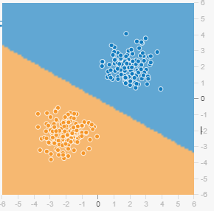
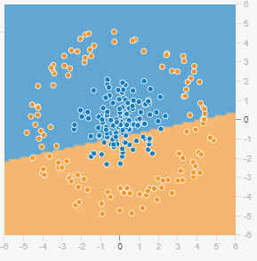


What can be learned?
Perceptrons can only give good results if the data are linearly separable.
Visulisation

Slide 18
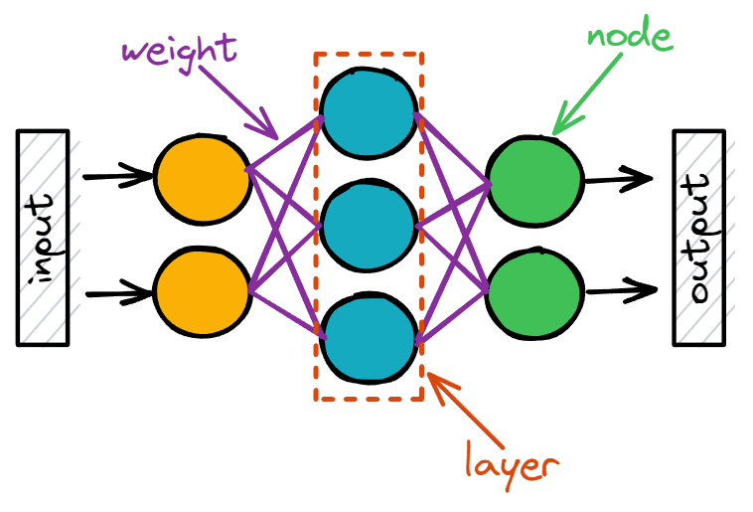
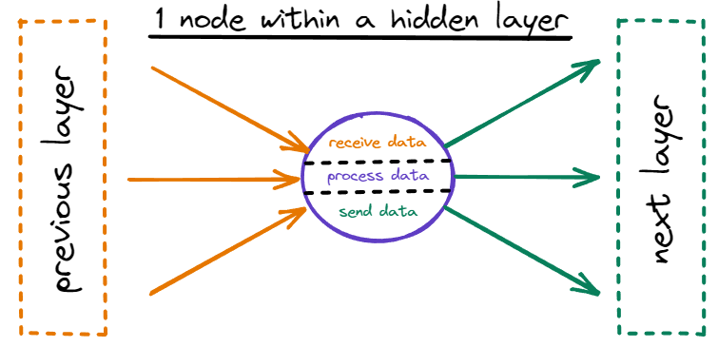
Networks
To get a neural network, multiple perceptrons can be orginized in layers.
Definition: An artificial neural network is a data processing system consisting of interconnected computing units called neurons/nodes. These are organized in layers and connected to each other with weights.
Propagating data from one layer to the next is called forward propagation.
Other Names:
ANN
NN
neural network
network
neural net
net
model

Slide 19
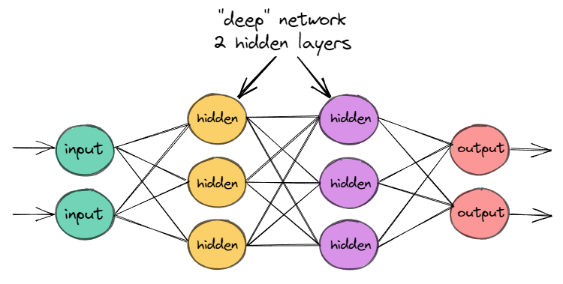
Overview ANN
ANNs consist of several layers, which in turn consist of several perceptrons (processing units).
There is an input layer for the input.
An output layer for prediction/classification.
Hidden layers that process the data.
If there are at least 2 hidden layers, the network is called "deep".
The neural networks are "trained" with existing data.
Notes:
Bild: https://deeplizard.com/lesson/dla3rzldai

Slide 20
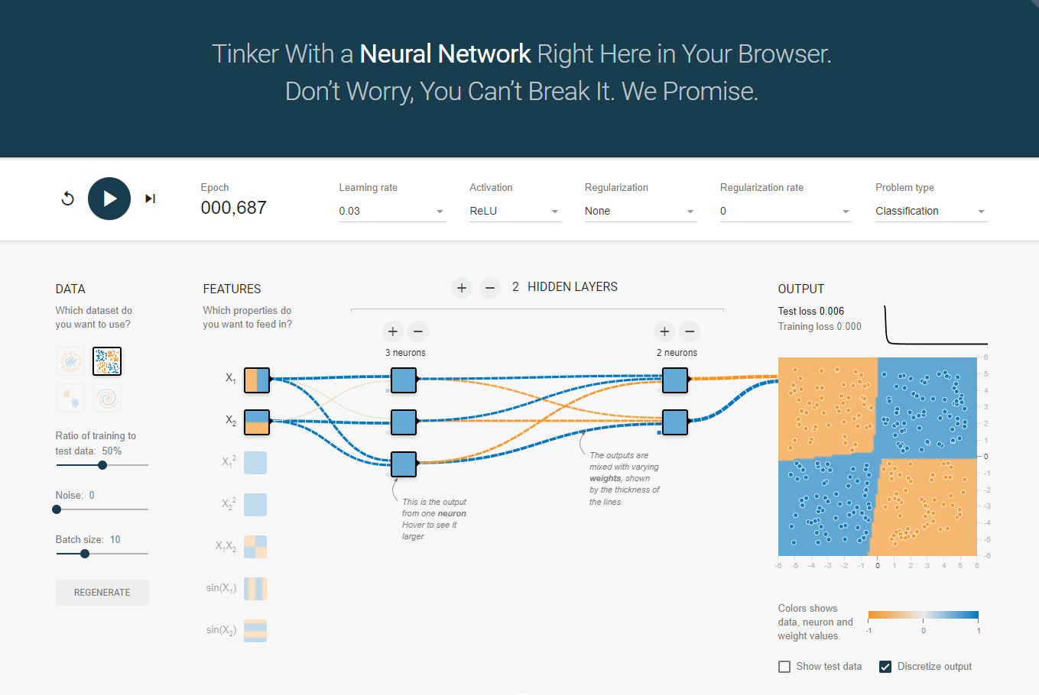
Multiple Layers
https://playground.tensorflow.org/

Slide 21
Parameters and hyperparameters
In a model, a distinction is made between parameters and hyperparameters.
Parameters: Variables within a model that are automatically adjusted during training (e.g. weights between layers)
Hyperparameter: Variable that is set before the training process and determines the behavior of the model (e.g. number and size of hidden layers, type of activation function, batch size, ...)
Finding the right hyperparameter is called hyperparameter tuning.

Slide 22
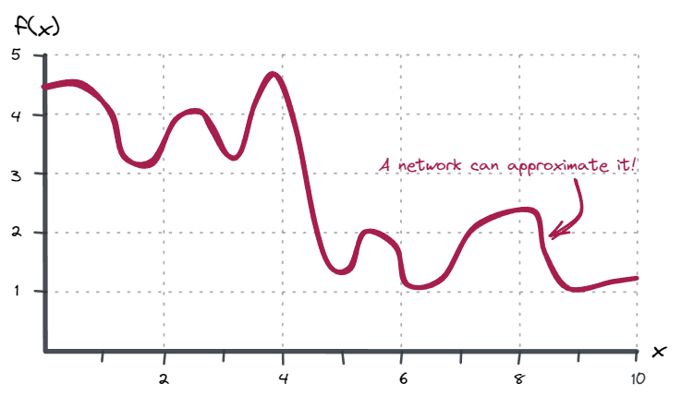
Warum sind neuronale Netze gut?
Das Universal Approximation Theorem besagt, dass ich jede Funktion durch ein Neuronales Netz approximieren lässt.

Slide 23
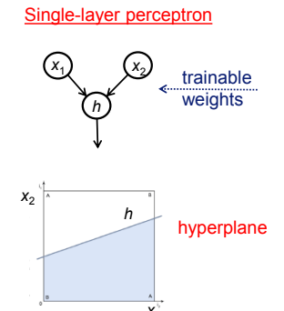
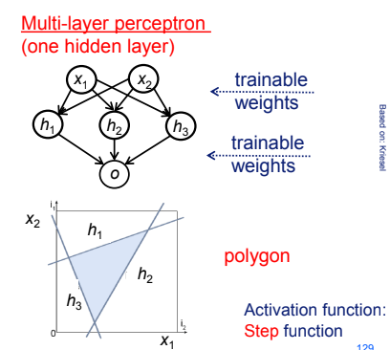
Classifikation mit MLP (Multi-Layer-Perceptron)

Slide 24
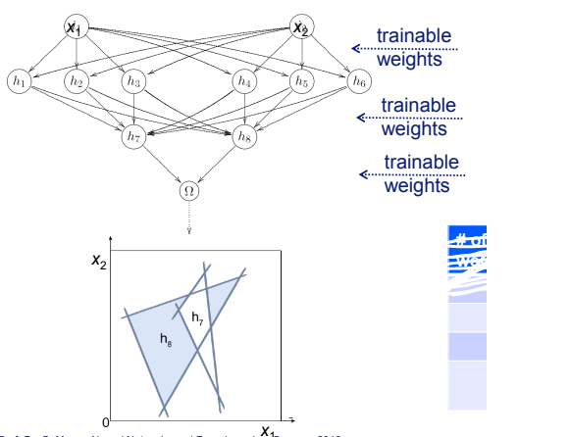
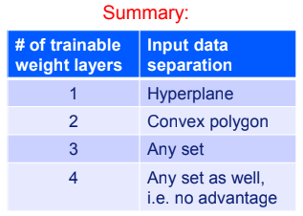
Klassifikation mit MLP (Multi-Layer-Perceptron)

Slide 25
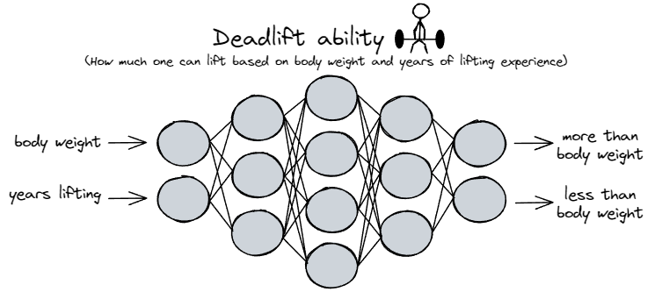
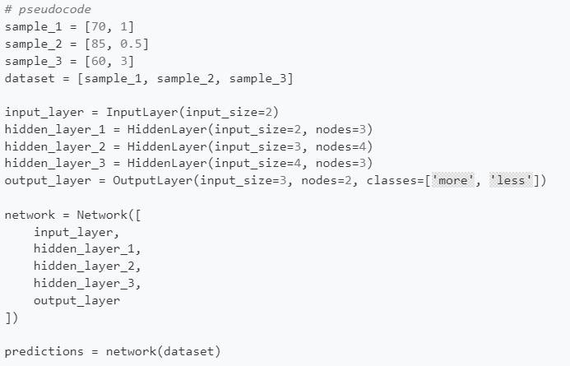
Pseudocode
First we need to set the number and size of the layers.
In this illustration we are working with fully connected (dense) layers, where all nodes of one layer are connected to all nodes of the next layer.

Slide 26
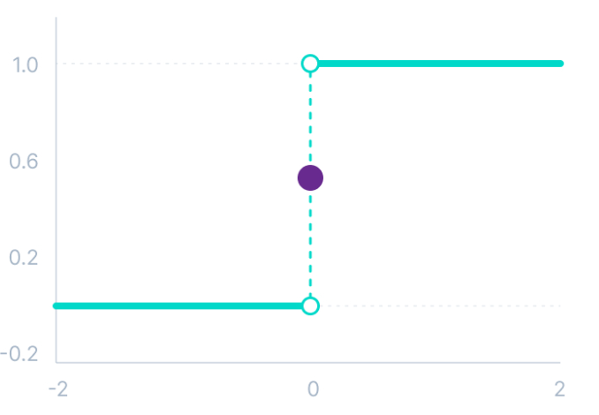

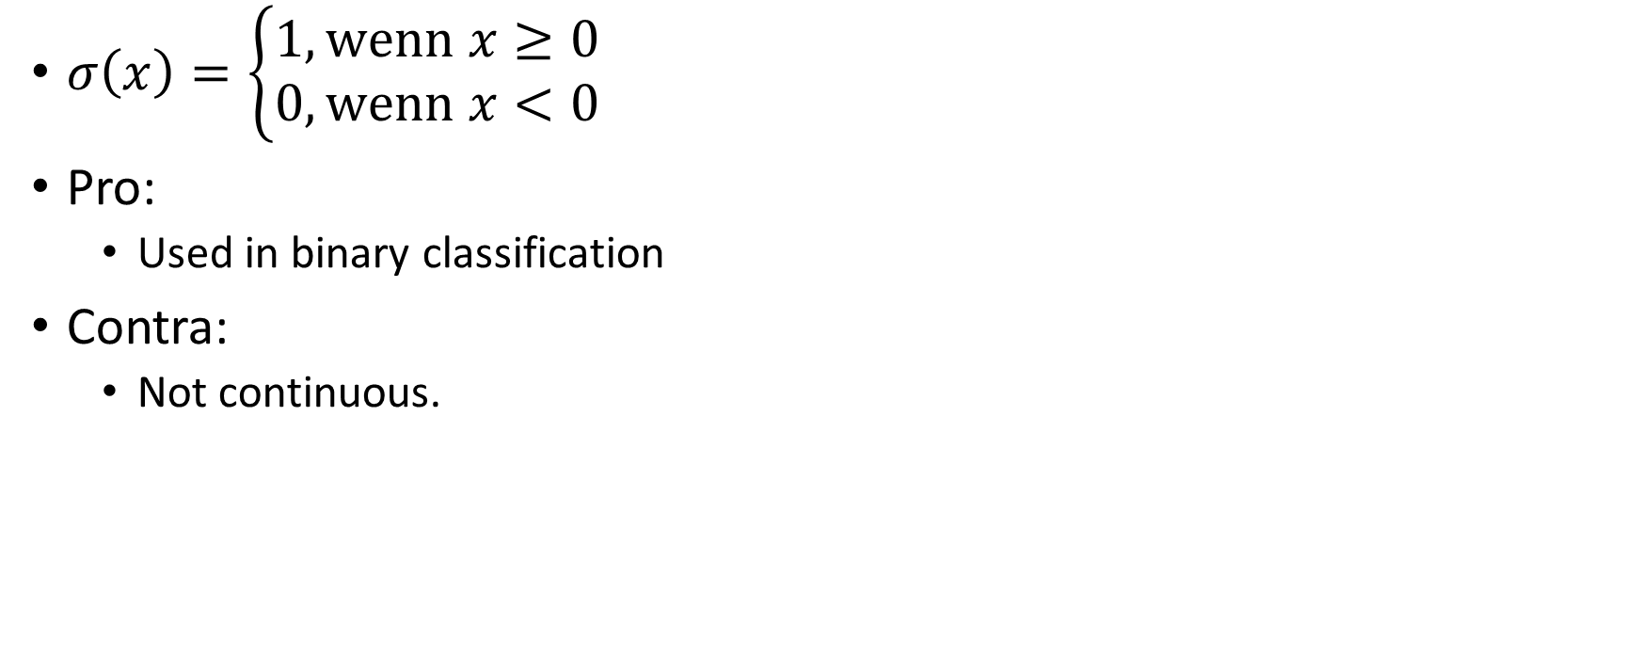
Binary Step
$$σ$$
$σ\left(x\right)=\left\{\begin{aligned}1, \text{wenn} x≥0 \\ 0, \text{wenn} x<0\end{aligned}\right.$
Pro:
Used in binary classification
Contra:
Not continuous.

Slide 27
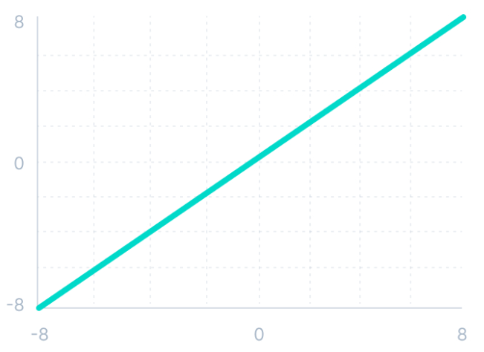
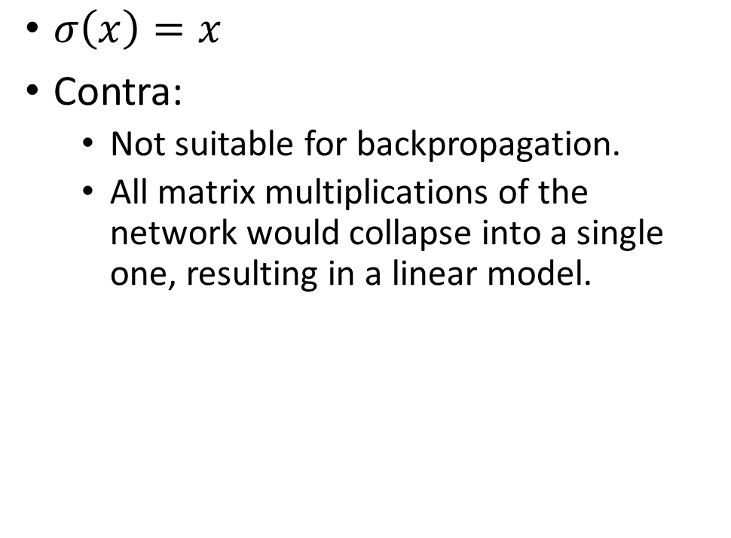
Linear
$$σ$$
$σ\left(x\right)=x$
Contra:
Not suitable for backpropagation.
All matrix multiplications of the network would collapse into a single one, resulting in a linear model.

Slide 28
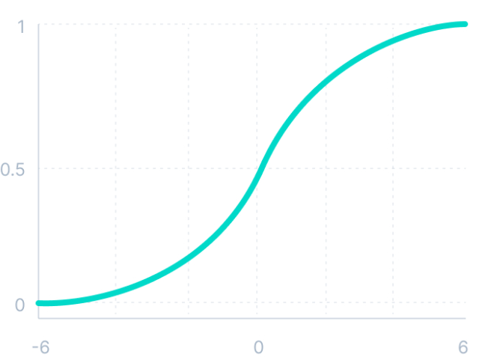
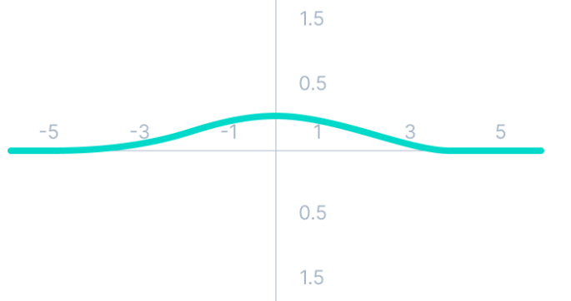


Sigmoid
$$σ$$
$σ\left(x\right)=\frac{1}{1+e^{−x}}∈(0,1)$
$σ^{′}=σ⋅\left(1−σ\right)$
Pro:
Continouos and & differentiable
Output corresponds to probabilities
Contra:
The derivative is very flat beyond $\left(−3, 3\right)$, so training almost stops (vanishing gradient problem).
The function is not point-symmetrical against $\left(0,0\right)$.
$$σ′$$

Slide 29



Tanh (tangens hyperbolicus)
$$σ$$
$σ\left(x\right)=\frac{e^{x}−e^{−x}}{e^{x}+e^{−x}}$
$σ^{′}=1−σ^{2}$
Pro:
Continuous & differentiable.
Higher values in the derivative.
Is preferred to sigmoid.
Point symmetric around (0,0) (helps with learning)
Contra:
Also has the vanishing gradient problem (but not as severe as sigmoid)
$$σ′$$

Slide 30



ReLU (Rectified Linear Unit)
$$σ$$
$σ\left(x\right)=\max\left(0,x\right)$
$σ^{′}=\left\{\begin{aligned}1, x>0 \\ 0,x<0\end{aligned}\right.$
Pro:
Fast to calculate
Differenciable (exept 0)
Contra:
Dying Relu Problem: Since $σ^{′}\left(x\right)=0$ for $x≤0$ model training is stopped.
$$σ′$$

Slide 31



Leaky ReLU
$$σ$$
$σ\left(x\right)=\max\left(0,01x,x\right)$
$σ^{′}=\left\{\begin{aligned}1 , \text{wenn} x>0 \\ 0,01 ,\text{wenn} x<0\end{aligned}\right.$
Pro:
Same as ReLU
No „Dying ReLU problem“.
Contra:
Since $0,01$ is very small, learning can take a long time.
Variant: Choosing $a=0,01$ diffrently $\left(a∈ℝ_{+}\right)$ is called „Parametric ReLU“ and can be used when Leaky ReLU is not converting.
$$σ′$$

Slide 32




ELU (exponential Linear Unit)
$$σ$$
$$σ′$$
$σ\left(x\right)=\left\{\begin{aligned}x, \text{wenn} x≥0 \\ α\left(e^{x}−1\right), \text{wenn} x<0\end{aligned}\right.$
$σ^{′}\left(x\right)=\left\{\begin{aligned}1, \text{wenn} x≥0 \\ σ\left(x\right)+α, \text{wenn} x<0\end{aligned}\right.$
Pro:
Is continuously differentiable.
Runs very evenly up to −𝛼.
No „Dead ReLU problem“.
Contra:
Slower calculation than ReLU because of the exponential function.
𝛼 is a hyperparameter
Exploding gradient problem (i.e. model does not converge)

Slide 33


Softmax
$σ{\left(x\right)}_{i}=\frac{e^{x_{i}}}{\sum_{j=1}^{n}{e^{x_{j}}}}$
Great visualization
The soft max function is only used in the last layer.
It takes all neurons of the previous layer into account during calculation.
Transforms inputs into probalitities: $\sum_{i=1}^{n}{σ{\left(x\right)}_{i}}=1$
Pro:
We used to print the probability for each neuron.
Great for classification

Slide 34


Other activation functions…
There are many other activation functions:
Swish: $\frac{x}{1+e^{−x}}$
Gelu: $x⋅Φ\left(x\right)$
SELU (Scales Exponantial Linear Unit)
Cosinus
…
Notes:
https://www.v7labs.com/blog/neural-networks-activation-functions

Slide 35
Which activation Function should i choose?
Output Layer:
Regression - Linear Activation Function
Binary Classification—Sigmoid/Logistic Activation Function
Multiclass Classification—Softmax
Multilabel Classification—Sigmoid
Hidden Layer:
Convolutional Neural Network (CNN): ReLU activation function.
Recurrent Neural Network (RNN): Tanh and/or Sigmoid activation function.

Slide 36


Calculating a Fully Connected Layer
The calculation works exactly like with the Perceptron, just in parallel with multiple ones.
This calculation can also be performed excellently using matrix multiplication.
$$I_{0}=\left(\begin{aligned}160 \\ 55\end{aligned}\right), I_{0}^{T}=\left(\begin{matrix}160 & 55\end{matrix}\right), M_{0}=\left(\begin{matrix}0,35 & −0,1 & 0,7 \\ 0,2 & −0,4 & 0,18\end{matrix}\right)$$
$$z=M_{0}^{T}⋅I_{0}^{ }=\left(\begin{matrix}0,35 & 0,2 \\ −0,1 & −0,4 \\ 0,18 & 0,7\end{matrix}\right)⋅\left(\begin{aligned}160 \\ 55\end{aligned}\right)=\left(\begin{aligned}160⋅0,35+55⋅0,2 \\ \begin{aligned}160⋅\left(−0,1\right)+55⋅\left(−0,4\right) \\ 160⋅0,7+55⋅0,18\end{aligned}\end{aligned}\right)=\left(\begin{aligned}67 \\ −38 \\ 121,9\end{aligned}\right)$$
Before passing it to the next layer, a non-linear activation function $σ$ is applied element-wise to $z$.
$$σ\left(x\right)=\max\left(x, 0\right)$$
$$σ\left(z\right)=\left(\begin{aligned}67 \\ 0 \\ 121,9\end{aligned}\right)=:I_{1}$$
Input -> matrix -> nicht linear akt-> matrix ->nicht linear akt -> matrix -> akt
4 * 3 * 5 = 4 * 15

Slide 37


Berechnung in einem Fully Connected Layer
No we can calculate the second layer:
$$I_{1}=\left(\begin{aligned}67 \\ 0 \\ 121,1\end{aligned}\right), M_{1}=\left(\begin{matrix}−1,72 & 1,7 \\ 0,5 & 0,1 \\ 1 & 1\end{matrix}\right),$$
$$z={M_{1}^{T}⋅I}_{1}=\left(\begin{aligned}67⋅\left(−1,72\right)+0⋅0,5+121⋅1 \\ 67⋅\left(−1,7\right)+0⋅1+121⋅1\end{aligned}\right)=\left(\begin{aligned}6.6 \\ 8\end{aligned}\right)$$
Finally we can use the softmax activation function to calculate propabilites:
$$σ{\left(x\right)}_{i}=\frac{e^{x_{i}}}{\sum_{j=1}^{n}{e^{x_{j}}}}$$
$$σ\left(\begin{aligned}6.6 \\ 8\end{aligned}\right)=\left(\begin{aligned}\frac{e^{6.6}}{e^{6.6}+e^{8}} \\ \frac{e^{8}}{e^{6.6}+e^{8}}\end{aligned}\right)=\left(\begin{aligned}0.2 \\ 0.8\end{aligned}\right)$$
-1,72
-1,7
0,5
0,1
1
6
1
7
1
$$\frac{1}{1+6+7}$$

Slide 38


Calculation Tasks
Task 1: Calculate the outputs of the neural network.
The input is $\left(\begin{aligned}i_{1} \\ i_{2}\end{aligned}\right)=\left(\begin{aligned}0.05 \\ 0.1\end{aligned}\right)$.
The weights can be seen in the illustration.The calculation goes as follows:
$$h_{1}=σ(w_{1}x_{1}+w_{2}x_{2}+b_{1})$$
$$h_{2}=σ(w_{3}x_{1}+w_{4}x_{2}+b_{1})$$
$$o_{1}=σ(w_{5}h_{1}+w_{6}h_{2}+b_{2})$$
$$o_{2}=σ(w_{7}h_{1}+w_{8}h_{2}+b_{2})$$
Compute the outputs when $σ$ is
ReLu,
Sigmoid.
Task 2: How to transfer the calculations from layer 1 to 2 Represent as matrix operations? How from layer 2 to 3?

Slide 39

Task 1
Task 1: Calculate the outputs of the neural network.
The input is $\left(\begin{aligned}i_{1} \\ i_{2}\end{aligned}\right)=\left(\begin{aligned}0.05 \\ 0.1\end{aligned}\right)$.
The weights can be seen in the illustration.
RELU:
$$h_{1}=σ\left(w_{1}x_{1}+w_{2}x_{2}+b_{1}\right)=σ\left(0.15⋅0.05+0.2⋅0.1+0.35\right)=σ\left(0.3775\right)=0.3775$$
$$h_{2}=σ\left(w_{3}x_{1}+w_{4}x_{2}+b_{1}\right)=σ\left(0.25⋅0.05+0.3⋅0.1+0.35\right)=σ\left(0.3925\right)=0.3925$$
$$o_{1}=σ\left(w_{5}h_{1}+w_{6}h_{2}+b_{2}\right)=σ\left(0.4⋅0.3775+0.45⋅0.3925+0.6\right)=σ\left(0.9276\right)=0.9276$$
$$o_{2}=σ\left(w_{7}h_{1}+w_{8}h_{2}+b_{2}\right)=σ\left(0.5⋅0.3775+0.55⋅0.3925+0.6\right)=σ\left(1.004625\right)=1.004625$$
Sigmoid:
$$h_{1}=σ\left(w_{1}x_{1}+w_{2}x_{2}+b_{1}\right)=σ\left(0.15⋅0.05+0.2⋅0.1+0.35\right)=σ\left(0.3775\right)=\frac{1}{1+e^{−0.3375}}=0.5932$$
$$h_{2}=σ\left(w_{3}x_{1}+w_{4}x_{2}+b_{1}\right)=σ\left(0.25⋅0.05+0.3⋅0.1+0.35\right)=σ\left(0.3925\right)=0.59688$$
$$o_{1}=σ\left(w_{5}h_{1}+w_{6}h_{2}+b_{2}\right)=σ\left(0.4⋅0.5932+0.45⋅0.59688+0.6\right)=σ\left(1.10587\right)=0.751359$$
$$o_{2}=σ\left(w_{7}h_{1}+w_{8}h_{2}+b_{2}\right)=σ\left(0.5⋅0.5932+0.55⋅0.59688+0.6\right)=σ\left(1.22488\right)=0.7729$$

Slide 40























Task 2…
Input
Hidden
Output
$$x_{1}$$
1
$$w_{11}^{1}$$
1
$$w_{11}^{2}$$
1
$$w_{21}^{1}$$
$$b_{1}^{1}$$
$$w_{21}^{2}$$
$$b_{1}^{2}$$
$$w_{12}^{1}$$
$$w_{12}^{2}$$
$$x_{2}$$
2
$$w_{22}^{1}$$
2
$$w_{22}^{2}$$
2
$$b_{2}^{1}$$
$$b_{2}^{2}$$
$$W^{1}=\left(\begin{matrix}w_{11}^{1} & w_{12}^{1} \\ w_{21}^{1} & w_{22}^{1}\end{matrix}\right), a^{0}≔x=\left(\begin{aligned}x_{1} \\ x_{2}\end{aligned}\right), b^{1}=\left(\begin{aligned}b_{1}^{1} \\ b_{2}^{1}\end{aligned}\right)$$
$$z_{1}^{1}=w_{11}^{1}{⋅x}_{1}^{ }+w_{12}^{1}⋅x_{2}^{ }+b_{1}^{1}$$
$$z_{2}^{1}=w_{21}^{1}{⋅x}_{1}^{1}+w_{22}^{1}⋅x_{2}^{1}+b_{2}^{1}$$
$${\left(\begin{aligned}z_{1}^{1} \\ z_{2}^{1}\end{aligned}\right)=z}^{1}=W^{1}a^{0}+b^{1}, {\left(\begin{aligned}a_{1}^{1} \\ a_{2}^{1}\end{aligned}\right)=a}^{1}=σ^{1}\left(z^{1}\right)$$
$$a_{1}^{1}=σ^{1}\left(z_{1}^{1}\right)$$
$$a_{2}^{1}=σ^{1}\left(z_{2}^{1}\right)$$
$$W^{2}=\left(\begin{matrix}w_{11}^{2} & w_{12}^{2} \\ w_{21}^{2} & w_{22}^{2}\end{matrix}\right), b^{2}=\left(\begin{aligned}b_{1}^{2} \\ b_{2}^{2}\end{aligned}\right)$$
$$z^{l}=W^{l}a^{l−1}+b^{l}, a^{l}=σ^{l}\left(z^{l}\right)$$
$$z_{1}^{2}=w_{11}^{2}⋅a_{1}^{1}+w_{12}^{2}⋅a_{2}^{1}+b_{1}^{2}$$
$$z_{2}^{2}=w_{21}^{2}⋅a_{1}^{1}+w_{22}^{2}⋅a_{2}^{1}+b_{2}^{2}$$
$$z^{2}=W^{2}a^{1}+b^{2}, a^{2}=σ^{2}\left(z^{2}\right)$$
$$a_{1}^{2}=σ^{2}\left(z_{1}^{2}\right)=σ^{2}\left(w_{11}^{2}⋅σ^{1}\left(w_{11}^{1}⋅x_{1}^{ }+w_{12}^{1}⋅x_{2}^{ }+b_{1}^{1}\right)+w_{12}^{2}⋅σ^{1}\left(w_{21}^{1}⋅x_{1}^{ }+w_{22}^{1}⋅x_{2}^{ }+b_{2}^{1}\right)+b_{1}^{2}\right)$$
$$a_{2}^{2}=σ^{2}\left(z_{2}^{2}\right)$$

Slide 41
Loss
The loss function describes the error that the model makes.
The aim is to minimize the loss in the course of training.
There is no guarantee that a global minimum will be found, only a local one.
The Loss feature can be customized in a variety of ways to achieve various side objectives.

Slide 42




Categorical Cross Entropy Loss
Predicted probability distribution: $\left[0.25, 0.75\right]$
Actual probability distribution: $[1, 0]$
Let 𝑞(𝑥) be the probability that the model correctly predicts the input 𝑥.
Then we define $loss(x)=−ln⁡(q(x))$as the Categorical Cross Entropy Loss.
In our example it is $loss(x)=−ln⁡(0.25)=1.3862$
We see that big mistakes are punished so much more than small mistakes.
100000 patients, 100 of them are ill
Model: Person is not ill.
Accuracy 999900 my model is correct and just 100 were misidentified. So my accuracy is 99.9%

Slide 43

Goal: Reduction of Loss
The goal is to reduce the loss function over the course of training iterations.
If there is more than one input (which will probably always be the case), the arithmetic mean is used to determine the total loss.
Trainings-
Iterationen

Slide 44
Note on binary classification
For a binary classification problem, one would use binary cross-entropy / log loss. This is exactly the one used in logistic regression.
Furthermore, one would work with the sigmoid function and a single node in the last layer, not with the softmax.
But in the end it comes down to the same thing mathematically.
Notes:
https://towardsdatascience.com/understanding-binary-cross-entropy-log-loss-a-visual-explanation-a3ac6025181a

Slide 45

Training
The aim of the model is a correct prediction, i.e. the lowest possible loss.
For this purpose, the parameters (weights) are trained.
The training runs with an optimizer.
The basic optimizer is Gradient Descent.

Slide 46


Gradient Descent
With gradient descent, the derivative of the loss function is examined after each individual weight. These are also called gradients:
$$\frac{d\left(loss\right)}{d\left(weight\right)}$$
Then the weights are updated:
$$new weight=weight−learning rate⋅\frac{d\left(loss\right)}{d\left(weight\right)}$$
Idea: the derivative always points in the direction of the maximum. − Derivation always in the direction of the minimum.
So we are going step by step towards the minimum.
Hence the name freely translated: "descent with the help of the slope“
To update the weights, the network is traversed backwards. The gradients are calculated very cleverly and weights are updated. This is called backpropagation.
The learning rate (hyperparameter) describes how far towards the minimum one goes. (comparable to step size)
Notes:
https://zitaoshen.rbind.io/project/optimization/1-min-of-machine-learning-gradient-decent/

Slide 47



Learning Rate
Usually between 0.01 and 0.0001.
The smaller the learning rate, the slower the learning.
Too high a learning rate prevents convergence at the minimum.
Many optimizers adjust the learning rate automatically or adaptively.

Slide 48




Backpropagation
Ableitung ausrechnen
Input
The name backpropagation comes from the fact that the weights are updated backwards.
The update is done so that the new weights better predict the target solution
The fact that the calculations work quickly is due to the chain rule:
$${\left(f∘g\right)}^{′}=g^{′}⋅f^{′}∘g$$
One can derive the front derivatives recursively using the back ones.

Slide 49




Gradient Descent
$$S=\left\{\left(x,y\right) | x Input, y Target zu x\right\}$$
Costfunction/Loss (z.B. MSE)
$$C=\frac{1}{2n}\sum_{\left(x,y\right)∈S}^{ }{{||y−\hat{y}\left(x\right)||}^{2}}$$
The gradient of C reveals in which direction
The steepest incline is
$$∇C=\left[\begin{aligned}\frac{∂C}{∂w_{ }^{1}} \\ \frac{∂C}{∂b_{ }^{1}} \\ ⋮ \\ \frac{∂C}{∂b_{ }^{L}}\end{aligned}\right]$$
This is how we get new weights and biases:
$${\hat{w}}_{ij}^{l}=w_{ij}^{l}−η⋅\frac{∂C}{∂w_{ij}^{l}}$$
$${\hat{b}}_{i}^{l}=b_{i}^{l}−η⋅\frac{∂C}{∂b_{i}^{l}}$$

Slide 50






Backpropagation:
http://neuralnetworksanddeeplearning.com/chap2.html
$σ(z^{l})$ applies $σ$ on every value of $z^{l}$:
$$σ\left(z^{l}\right)=\left(\begin{aligned}σ(z_{1}^{l}) \\ σ(z_{2}^{l}) \\ ⋮ \\ σ(z_{n}^{l})\end{aligned}\right)$$
$$∇_{a}C=\left(\begin{aligned}\frac{∂C}{∂a_{1}^{L}} \\ ⋮ \\ \frac{∂C}{∂a_{n_{L}}^{L}}\end{aligned}\right)=\left(\begin{aligned}a_{1}^{L}−y_{1} \\ ⋮ \\ a_{n_{L}}^{L}−y_{n_{L}}\end{aligned}\right)=a^{L}−y$$
$⊙$ is the „Hadamard Produkt“.
This describes the element mode
Multiplication of two matrices.
$$\frac{∂C}{∂w^{l}}=δ^{l}{\left(a^{l−1}\right)}^{t} \text{and}\frac{∂C}{∂b^{l}}=δ^{l}$$
6. Update: For each $l=1,2,…,L$ update
$${\hat{w}}_{ }^{l}=w_{ }^{l}−η⋅\frac{∂C}{∂w_{ }^{l}}=w_{ }^{l}−η⋅δ^{l}{\left(a^{l−1}\right)}^{t}$$
$${\hat{b}}_{ }^{l}=b_{ }^{l}−η⋅\frac{∂C}{∂b_{ }^{l}}=b_{ }^{l}−η⋅δ^{l}$$
Full Example Calculation

Slide 51


Other Optimizier
ADAM: Adaptive moment Estimator
Adaptive Learning Rate
Momentum is adjusted to converge faster (brake in time before falling out of local minimum)
There are many other Optimizer.

Slide 52


Batchsize
Training Data
Updating the weights during backpropagation can not only be based on each individual sample, but also based on several.
We could first calculate the total loss of the entire training data and only then update the weights.
Better: We divide our training data into batches and only update once per batch(Mini Batch Gradient Descent).
Batchsize is a hyperparameter.
Bigger Batchsize → Faster Training & worse predictive power.
An epoch describes a training run with all training data.
The number of epochs is a hyperparameter
$Batches per Epoch=\frac{dataset size}{batch size}$
Batch 1
Batch 2
Batch 3
Batch 4

Slide 53



Base types von Optimizern
Name | Time of Update | Pro | Contra
Batch Gradient Descent | Einmal am Ende des Epochs | Always improving | Very slow (especially for big datasets)
Stochastic Gradient Descent | After each sample | Good Learning Speed | Bad convergence
Mini-Batch Gradient Descent | After each mini-batch | Good learning speed Good convergence
Unfortunatly there are different naming convention in literature for this topic ☹

Slide 54


Number of learnable parameters
Parameters per Layer:
$$\#inputs⋅\#outputs+\#biases$$

Slide 55

Training, Validation & Test Split
Mit dem Trainigsset wird das Model trainiert.
Mit dem Validation Set wird die Qualität des Models während des Trainings geprüft. Wichtig, um Over- & Underfitting zu erkennen. Es findet kein Training mit diesem Datensatz stat.
Das Testset wird nach dem Training Ende zur Qualitätsermittlung genutzt.

Slide 56



Under- & Overfitting
Underfitting describes that the model learns the training set too badly (train-accuracy remains low). Model might not be complex enough to train.
Overfitting describes that the model learns the training model too well, but not the validation data. (train- and test-accuracies diverge).

Slide 57
Techniques to avoid overfitting
More training data
data augmentation
Reduce complexity (number of parameters) in the model
Increase regularization (L1, L2, dropout, ...)

Slide 58
Avoid underfitting
Increase complexity (number of parameters) of our model. (The model does not have enough parameters to describe the problem).
Find more features (increase amount of information).
Reduce regularization.

Slide 59


Data Augmentation
To avoid overfitting, it is beneficial to increase the size of our dataset using data augmentation.
This means applying various techniques to vary our inputs.
Please ensure that these variations do not lead to different labels.
ImageDataGenerator

Slide 60
Biases im Datensatz überprüfen
Our dataset can inherently have biases.
For example, most American tanks are photographed in good weather conditions, while Russian tanks are photographed in bad weather conditions.
Critically examine which biases exist, such as
underrepresentation of certain skin tones,
genders,
camera angles,
etc.
Can you find the bias present in the training data? https://mco-mnist-draw-rwpxka3zaa-ue.a.run.app/

Slide 61

Regularizierung
Describes techniques that help the model improve generalization without reducing training metrics.
L1 & L2 regularization adds a penalty term to the loss function that penalizes high complexity of the model.
Costfunction: $Cost=Loss+λ⋅Ω$
$$Ω_{L1}=\sum_{w∈Weight}^{ }{\left|w\right|}, Ω_{L2}=\frac{1}{2}\sum_{w∈Weight}^{ }{w^{2}}$$
L1: Small weights tend to 0.
L2: Large weights are heavily penalized, while small weights are penalized less.
$λ$ describes the influence of regularization.

Slide 62

Dropout
During training, different nodes are repeatedly excluded from the training process.
The model becomes less reliant on a few specific parameters.
As a result, the model effectively has fewer trainable parameters per step.

Slide 63

Data Pre-processing
Sammeln: Im einfachsten Fall herunterladen. Wie werden die Informationen gesammelt und welche Biase entstehen?
Organisieren: Training-, Validation-, Testset. Ordnerstruktur für die Modelle anpassen.
Resize, Reshape: Form und Farbe der Bilder uniform machen.
Nomalisieren: Features in eine Normalverteilung umrechnen.
Standartisieren: Features transformieren, sodass sie zwischen 0 und 1 liegen.
Augmentieren
Collect
Organize
Resize, Reshape
Normilize,
standardize
Augmentation

Slide 64



Normalisieren
Name | Formel | Ergebnis | Methode
Normalisieren (Min/Max) | $$\tilde{x_{i}}≔\frac{x_{i}−x_{min}}{x_{max}−x_{min}}$$ | Alle Daten liegen zwischen 0 und 1. | MinMaxScalar minmax_scale
Standardisierung (Z-Transformation) | $$\tilde{x_{i}}≔\frac{x_{i}−\overline{x}}{σ_{ }}$$ | Daten sind um die 0 herum normalverteilt. | StandardScaler scale
Log-Transformation | $$\tilde{x_{i}}≔\log_{ }(x_{i})$$ | Daten die extrem schief sind, werden gleichmäßiger verteilt. | FunctionTransformer

Slide 65




Änderung der Verteilung

Slide 66

Bilder an NN übergeben
We can interpret each pixel as an input. (Flattening)
When each input is connected to every node in the hidden layer, the number of parameters quickly increases.
Furthermore, the spatial relationship between pixels is lost (practically, all pixels are considered adjacent).

Slide 67

Besser:
Reduce the number of connections between two layers to:
Preserve the spatial relationship,
Reduce the number of parameters.

Slide 68

Convolutional Neural Network (CNN)
CNNs (Convolutional Neural Networks) have specialized convolutional layers and are particularly well-suited for processing image data.

Slide 69

Computer Vision tasks
Computer vision enables a machine to understand and process visual data, such as images and videos.
Data is a valuable asset because it forms the basis for deep learning algorithms.
How would you attempt to solve these problems using conventional instructions?
Difficult...
Notes:
Bild: https://deeplizard.com/lesson/dla3rzldai

Slide 70



Convolutional Layer
The task of the convolutional layer is to detect structures in the image.
A layer consists of filters, which can be compared to nodes in a regular layer.
Later filters in the CNN are capable of recognizing complex structures.
The first filters just detect simple structures like edges or corners.
In each layer, we can specify the size and number of filters.

Slide 71



Filter
Filters are matrices that are sequentially applied to the fields of the input.
Matrix values are adjusted during training (thus, they are parameters).
The number of filters determines the number of outputs of the layer.
Diese Filterwerte werden trainiert.

Slide 72






Convolution Operation
28x28x1
Sliding Window
Stride describes how many steps are taken after each operation.
Demo
Output size: ${\left(\frac{n−f}{s}+1\right)}^{2}$, $n$ size of input, $f$ size of filters, $s$ stride.

Slide 73
Ein Filter
100x100x3
96x96
4x4x3

Slide 74
mehrere Filter
4x4x3
4x4x3
100x100x3
4x4x8
96x96x8
4x4x3
4x4x3
4x4x3
4x4x3
4x4x3
4x4x3

Slide 75


Effect of Convolution
Convolutions can reduce the size of an image

Slide 76


Zero Padding
Valid padding: The image becomes smaller as no padding is added around it during the convolution operation.
Same padding: Zeros are added around the image so that the output size remains the same as the input size.
Visualization

Slide 77

Later Filters
Later filters detext more complex structures.

Slide 78

Even more later filters
Even later filters can detect very complex parts of an image

Slide 79

Less parameters to train

Slide 80




Size Example

Slide 81





Max Pooling
The size of the input is reduced by taking the maximum value from each pooling operation and discarding the rest.
Visualization
Output size: ${\left(\frac{n−f}{s}+1\right)}^{2}$, $n$ size of input, $f$ size of filter, $s$ stride.
Goal: Reducing the size of the image helps to:
Focus on important features.
Decrease the number of parameters.
Avoid overfitting.
There are also other pooling technics (like Average Pooling)

Slide 82



Size example

Slide 83


Batch Normalization
Eine Normalisierung kann nicht nur am Anfang des Netzes passieren, sondern kann auch am zwischen drin eingefügt werden.
Formel: $BN\left(x\right)=\left(\frac{x−μ}{σ}\right)⋅γ+β$
$γ$ und $β$ sind trainierbare Parameter.
$μ$ ist das Arithmetische Mittel und $σ$ die Standardabweichung des Batches.
Batch Normalisierung für zu weniger extremen Werten, was die Stabilität beim Lernen verbessert.

Slide 84
Neues Netzwerk erstellen…
Collecting and preparing the dataset.
Creating the network architecture.
Training the network with data.
Measuring performance.
Adjusting hyperparameters and network structure.
Repeating the training...
It can be quite challenging and time-consuming.
How many layers?
Which layers?
How many nodes per layer?
...

Slide 85



Transfer Learning Fine-tuning
Utilize the solution of one problem to apply it to another problem.
Here: Use a network that has been trained on a similar problem and adapt it for our problem.

Slide 86

Sequential Model in Keras
Sequential ist ein Model, bei dem Layer nacheinander abgearbeitet werden.
Flatten translates multidimensional inputs to 1-dimensional output.
Dense is a fully connected layer.
Dropout randomly removes neurons from training.

Slide 87


Train model
You train a model with fit.
fit gives you a History Objekt.

Slide 88


EarlyStopping
EarlyStopping allows the learning process to be terminated prematurely if no improvements are observed for a certain number of periods.
ModelCheckpoint saves the best performing version of the model.

Slide 89

save model
Use save to save your model.
Datatype: h5
Use load_model to load your model.
Models can also be saved in JSON or YAML format.
to_json
model_from_json
to_yaml
model_from_yaml

Slide 90

More different Layers
Conv2D
MaxPooling2D
Dropout

Slide 91
Functional Model
The Functional API of Keras allows for the creation of more complex network topologies.
Layers are connected to each other to form a directed acyclic graph, where there can be multiple inputs or outputs.
Branching and loops are also possible within the network structure.

Slide 92

Functional Model
Layer objects are given as Parameters to the next obect.

Slide 93

Semantic Segmentation
Semantic Segmentation classifies every pixel in an image.
Used for understanding scenes at the pixel level.
Commonly applied in self-driving cars, robotics, and medical imaging.
Differentiates object classes but does not distinguish object instances.
Pretrained Model: https://github.com/divamgupta/image-segmentation-keras
Tool to create labeled data: Labelme

Slide 94

U-net
Notes:
https://arxiv.org/pdf/1505.04597.pdf

Slide 95

Implementing you own U-net
https://github.com/bnsreenu/python_for_microscopists/blob/master/074-Defining%20U-net%20in%20Python%20using%20Keras.py
Take a look at your funcional net:
Example: https://www.kaggle.com/code/bulentsiyah/deep-learning-based-semantic-segmentation-keras
Notes:
https://www.youtube.com/watch?v=RaswBvMnFxk

Slide 96
Embedding
Embedding discribes the representation of data in a lower-dimensional space for analysis.
Example: Represent 1.000.000 words in a 300-dimensional space.
Goal: we want to have similar words being close together in embedding space.
queen
word | dim1 | dim2
queen | 1.2 | 0.2
king | 1.1 | 0.3
woman | 1.05 | 1.4
man | 0.95 | 1.5
king
woman
man
King-man+woman=queen

Slide 97
Sparse Vector approach
A more intuitive way to map our words to vectors me be to one-hot-encoding.
Methods like this create sparse vectors with many zeros.
Inputvectors are extremly big and contain nearly no information.
Context is lost.
Cannot work with unknown words.
There are many different counting methods, that are not commonly used anymore:
Bag-of-words
N-gram
TF-IDF
word | dim1 | dim2 | dim3 | dim4
queen | 1 | 0 | 0 | 0
king | 0 | 1 | 0 | 0
woman | 0 | 0 | 1 | 0
man | 0 | 0 | 0 | 1

Slide 98
Embedding Layer
Output
Oft we have an Embedding Layer before the actual model.
You can train you own Embedding Layer or use a pretrained one.
Model
Embedding Layer
Input

Slide 99
Word2Vec
Word2Vec works by predicting the word based on surrounding words (Continuos Bag or Words - CBOW) or by predicting the surrounding words.
…The answer was found! This is how we can do this. His eyes sparked....
answer
answer
was
was
found
found
This outputs are used as the embedding dimensions.
The input weights are used as the embedding dimensions.
COBW
Skip-gram
N=6
Notes:
https://www.youtube.com/watch?v=viZrOnJclY0

Slide 100
Even more Embeddings…
fastText (uses subwords)
GloVe
ELMo
…
ChatGTP
uses
Transformer
uses
Embedding

Slide 101
Recurrent Neural Networks
Recurrent Neural Networks (RNNs) process sequential data of any length.
"Memory" retains information from previous inputs.
RNNs can struggle to learn long-term dependencies.
Countermeasure: Long Short-Term Memory (LSTM) or Gated Recurrent Units (GRU).
Applications: Speech recognition, text generation, time series analysis.

Slide 102



RNN
Let $X≔\left(x_{1},x_{2},…,x_{n}\right)$ be a sequential input.
An RNN calculate one entry at a time.
This is done in two steps:
Calculate the „memory“ (also called „hidden state“)based on the input and the old memory: $h_{t}≔σ_{h}\left(Ux_{t}+Vh_{t−1}+b_{h}\right)$
Calculate an output entry based on the current memory: $o_{t}≔σ_{o}\left(Wh_{t}+b_{o}\right)$
Parameters: $U, V, W,b_{h}, b_{o}$
$$h_{1}=\left(\begin{aligned}−1 \\ 3\end{aligned}\right), x_{2}=\left(\begin{aligned}1 \\ 2\end{aligned}\right), U=\left(\begin{matrix}0 & 2 \\ 1 & 1\end{matrix}\right),$$
$$Ux=\left(\begin{aligned}4 \\ 3\end{aligned}\right),$$
are
you
here?
Notes:
https://en.wikipedia.org/wiki/Recurrent_neural_network#/media/File:Recurrent_neural_network_unfold.svg

Slide 103


RNN
the old memory: $h_{t}≔σ_{h}\left(Ux_{t}+Vh_{t−1}+b_{h}\right)$
: $o_{t}≔σ_{o}\left(Wh_{t}+b_{o}\right)$
Parameters: $U, V, W,b_{h}, b_{o}$
$$h_{1}=\left(\begin{aligned}−1 \\ 3\end{aligned}\right), x_{2}=\left(\begin{aligned}1 \\ 2\end{aligned}\right), U=\left(\begin{matrix}0 & 2 \\ 1 & 1\end{matrix}\right), V=\left(\begin{matrix}3 & −1 \\ 2 & 2\end{matrix}\right), b_{h}=\left(\begin{aligned}1 \\ 1\end{aligned}\right)$$
$$Ux_{2}=\left(\begin{aligned}4 \\ 3\end{aligned}\right), Vh_{1}=\left(\begin{aligned}−6 \\ 4\end{aligned}\right), σ_{h}\left(Ux_{2}+Vh_{1}+b_{h}\right)=σ_{h}\left(\begin{aligned}−1 \\ 8\end{aligned}\right)=\left(\begin{aligned}0 \\ 8\end{aligned}\right)=h_{2}$$
are
you
here?
Notes:
https://en.wikipedia.org/wiki/Recurrent_neural_network#/media/File:Recurrent_neural_network_unfold.svg

Slide 104

RNN inner working
Let $X≔\left(x_{1},x_{2},…,x_{n}\right)$ be a sequential input.
An RNN calculate one entry at a time.
This is done in two steps:
Calculate the „memory“ (also called „hidden state“)based on the input and the old memory: $h_{t}≔σ_{h}\left(Ux_{t}+Vh_{t−1}+b_{h}\right)$
Calculate an output entry based on the current memory: $o_{t}≔σ_{o}\left(Wh_{t}+b_{o}\right)$
Parameters: $U, V, W,b_{h}, b_{o}$
Notes:
https://en.wikipedia.org/wiki/Recurrent_neural_network#/media/File:Recurrent_neural_network_unfold.svg

Slide 105

RNN kinds
Kind | example
one-to-one | vanilla model (not realy RNN), feed-forward network
one-to-many | Music generation based on genre (input)
many-to-one | Sentiment analysis: predict a score based on a sequence of words.
many-to-many (unsynchronized) | Translation of a text from one language to another.
many-to-many (synchronized) | Video Classification on frame-by-frame basis.
Furthermore you can stack multiple RNN-Layers vertically. (deep)
There are also bidirectional RNNs (ex: filling in missing words).
After an RNN layer other layers may follow.
Notes:
https://towardsdatascience.com/understanding-bidirectional-rnn-in-pytorch-5bd25a5dd66

Slide 106

Problems of RNNs
Vanishing Grandient
Exploding Gradient
Sequential Computation
Difficulty in Capturing Long-Term Dependencies
Long Training

Slide 107


Long Short Term Memory (LSTM)
LSTM use „gates“ to regulate information flow.
Forget gate
Input gate
Output gate
Last output $h_{t−1}$ and memory state $C_{t−1}$ are seperated and are both taken into account when calculation the new output $h_{t}$ and memory state $C_{t}$.
No more vanishing-gradient-problem.
Better at learning long-term dependencies.

Slide 108

Forget-Gate
$f_{t}=σ\left(W_{f}⋅\left[h_{t−1},x_{t}\right]+b_{f}\right)$
Since $σ∈\left[0,1\right]$ the Forget-Gate discribes, what part of the memory should be cleared ($0$) or kept ($1$).

Slide 109

Input-Gate
$i_{t}=σ\left(W_{i}⋅\left[h_{t−1},x_{t}\right]+b_{i}\right)$
Since $σ∈\left[0,1\right]$ the Input-Gate discribes, what part of the input and and old output should be remembered ($1$) or not ($0$).
$\tilde{C_{t}}≔\tanh{(W_{c}⋅\left[h_{t−1},x_{t}\right]+b_{c})}$
Since $\tanh{∈\left[−1,1\right]}$, it normalizes the output for the new suggested Cell state $\tilde{C_{t}}$.

Slide 110

Cell State
$C_{t}=f_{t}⨀C_{t−1}+i_{t}⨀\tilde{C_{t}}$
Calculate the new Cell state (state of mind)

Slide 111

Output-Gate
$o_{t}≔σ\left(w_{o}⋅\left[h_{t−1},x_{t}\right]+b_{o}\right)$
Calculate the output unconcerned with the state of mind.
$h_{t}≔o_{t}⨀tanh\left(C_{t}\right)$
Calculate the actual output, that takes the state of mind into account.

Slide 112

Output-Gate
$f_{t}=σ\left(W_{f}⋅\left[h_{t−1},x_{t}\right]+b_{f}\right)$
$i_{t}=σ\left(W_{i}⋅\left[h_{t−1},x_{t}\right]+b_{i}\right)$
$\tilde{C_{t}}≔\tanh{(W_{c}⋅\left[h_{t−1},x_{t}\right]+b_{c})}$
$C_{t}=f_{t}⨀C_{t−1}+i_{t}⨀\tilde{C_{t}}$
$o_{t}≔σ\left(W_{o}⋅\left[h_{t−1},x_{t}\right]+b_{o}\right)$
$h_{t}≔o_{t}⨀tanh\left(C_{t}\right)$
Parameters:$W_{f}, W_{i},W_{c},W_{o},b_{f},b_{i},b_{c},b_{o}$

Slide 113







Output-Gate
$$W_{f}=\left(\begin{matrix}1 & 2 & 3 & 4 & 5 & 6 \\ 1 & 2 & 3 & 4 & 5 & 6 \\ 1 & 2 & 3 & 4 & 5 & 6\end{matrix}\right)$$
$$σ\left(W_{f}⋅\left[h_{1}, x_{2}\right]+\left(\begin{aligned}0 \\ 0 \\ 0\end{aligned}\right)\right)=σ\left(\begin{aligned}3 \\ −3.5 \\ 0\end{aligned}\right)=\left(\begin{aligned}0.9 \\ 0.03 \\ 0.5\end{aligned}\right)$$
$f_{t}=σ\left(W_{f}⋅\left[h_{t−1},x_{t}\right]+b_{f}\right)$
$i_{t}=σ\left(W_{i}⋅\left[h_{t−1},x_{t}\right]+b_{i}\right)$
$\tilde{C_{t}}≔\tanh{(W_{c}⋅\left[h_{t−1},x_{t}\right]+b_{c})}$
$C_{t}=f_{t}⨀C_{t−1}+i_{t}⨀\tilde{C_{t}}$
$o_{t}≔σ\left(W_{o}⋅\left[h_{t−1},x_{t}\right]+b_{o}\right)$
$h_{t}≔o_{t}⨀tanh\left(C_{t}\right)$
Parameters:$W_{f}, W_{i},W_{c},W_{o},b_{f},b_{i},b_{c},b_{o}$
$$C_{1}=\left(\begin{aligned}2 \\ −0.5 \\ 1\end{aligned}\right)$$
$$h_{1}=\left(\begin{aligned}−1.2 \\ 0.2 \\ 0.5\end{aligned}\right)$$
$$\left[h_{1},x_{2}\right]=\left(\begin{aligned}−1.2 \\ 0.2 \\ 0.5 \\ 1 \\ 2 \\ 1\end{aligned}\right)$$
$$x_{2}=\left(\begin{aligned}1 \\ 2 \\ 1\end{aligned}\right)$$
$$\left(\begin{aligned}2⋅0.9 \\ −0.5⋅0.03 \\ 1⋅0.5\end{aligned}\right)=\left(\begin{aligned}1.8 \\ −0.015 \\ 0.5\end{aligned}\right)$$

Slide 114


Gated recurrent unit (GRU)
$r_{t}≔σ\left(W_{r}⋅\left[h_{t−1},x_{t}\right]+b_{r}\right)$
$z_{t}≔σ\left(W_{z}⋅\left[h_{t−1},x_{t}\right]+b_{z}\right)$
$\tilde{h_{t}}≔\tanh\left(W_{h}⋅\left[h_{t−1}⨀r_{t},x_{t}\right]+b_{h}\right)$
$h_{t}≔\left(1−z_{t}\right)⨀h_{t−1}+z_{t}⨀\tilde{h_{t}}$
What are the parameters?
How can we interpret each calculation?

Slide 115
GRU
Work faster (due to less Parameters) than LSTM
Need less training data
Less prone to overfitting

Slide 116
Example
https://www.kaggle.com/code/viktorreichert/rnn-steam-rating
Notes:
https://www.geeksforgeeks.org/sentiment-analysis-with-an-recurrent-neural-networks-rnn/

